Slide 1

Optimization Algorithms
1 Mini-batch gradient descent
2 Understanding mini-batch gradient descent
3 Exponentially weighted averages
4 Understanding exponentially weighted averages
5 Bias correction in exponentially weighted average
6 Gradient descent with momentum
7 RMSprop
8 Adam optimization algorithm
9 Learning rate decay
10 The problem of local optima

Slide 2
Optimization Algorithms
Mini-batch gradient descent

Slide 3
Mini-batch gradient descent
In machine learning, gradient descent is an optimization technique used for computing the model parameters (coefficients and bias) for algorithms like linear regression, logistic regression, neural networks, etc. In this technique, we repeatedly iterate through the training set and update the model parameters in accordance with the gradient of the error with respect to the training set. Depending on the number of training examples considered in updating the model parameters, we have 3-types of gradient descents:
Batch Gradient Descent: Parameters are updated after computing the gradient of the error with respect to the entire training set
Stochastic Gradient Descent: Parameters are updated after computing the gradient of the error with respect to a single training example
Mini-Batch Gradient Descent: Parameters are updated after computing the gradient of the error with respect to a subset of the training set

Slide 4
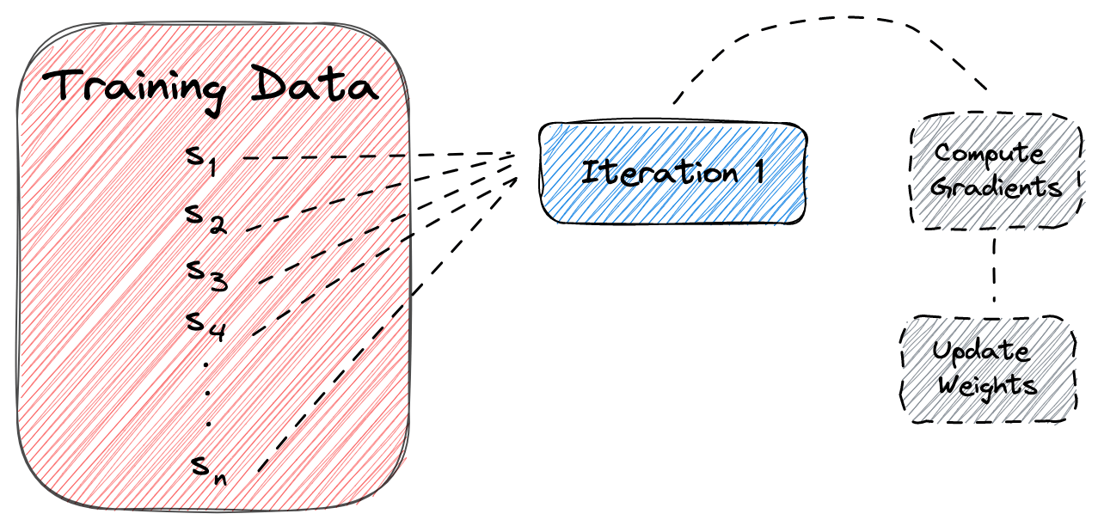
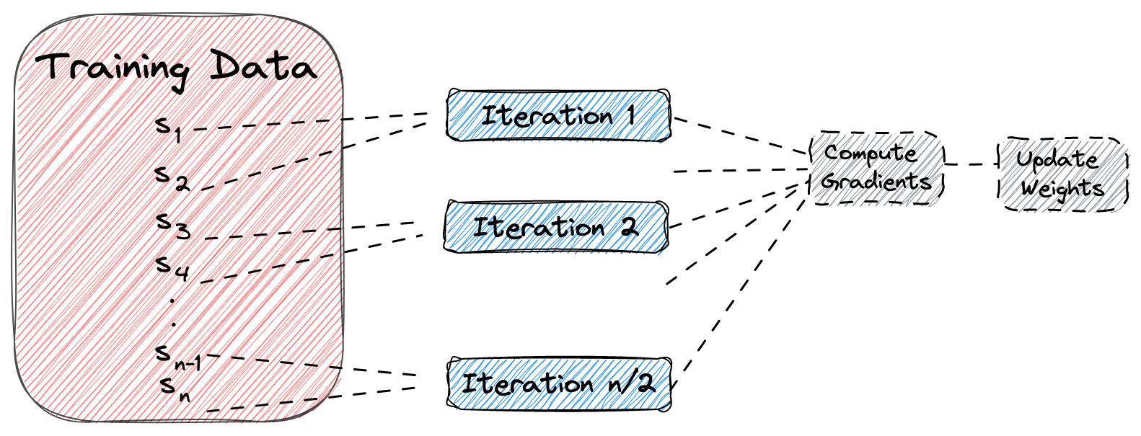
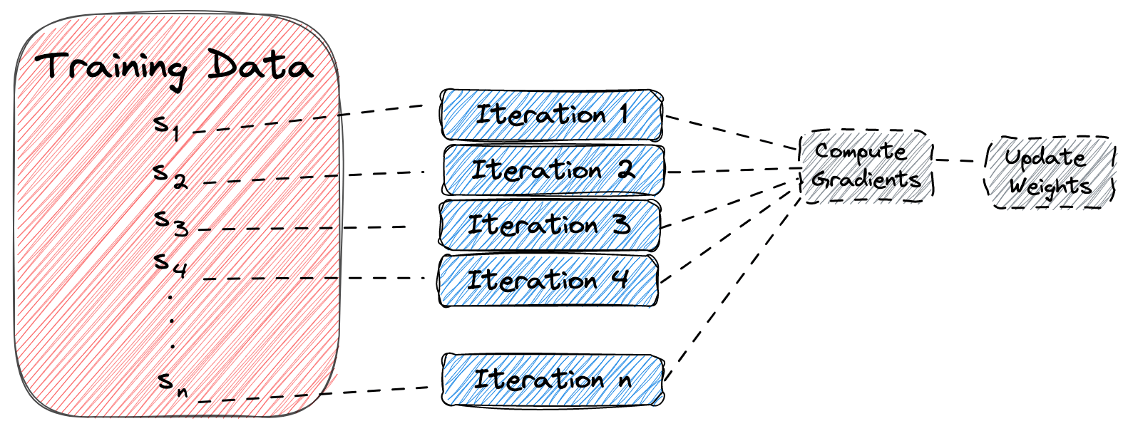
Mini-batch gradient descent
Batch Gradient Descent
Mini-Batch Gradient Descent
Stochastic Gradient Descent

Slide 5
Mini-batch gradient descent
Batch Gradient Descent | Stochastic Gradient Descent | Mini-Batch Gradient Descent
Since the entire training data is considered before taking a step in the direction of gradient, therefore it takes a lot of time for making a single update. | Since only a single training example is considered before taking a step in the direction of gradient, we are forced to loop over the training set and thus cannot exploit the speed associated with vectorizing the code. | Since a subset of training examples is considered, it can make quick updates in the model parameters and can also exploit the speed associated with vectorizing the code.
It makes smooth updates in the model parameters | It makes very noisy updates in the parameters | Depending upon the batch size, the updates can be made less noisy – greater the batch size less noisy is the update
In this lesson, we only study mini-batch gradient descent.

Slide 6
Mini-batch gradient descent
An epoch means that we have passed each sample of the training set one time through the network to update the parameters. Generally, the number of epochs is a hyperparameter that defines the number of times that gradient descent will pass the entire dataset.
If we look at the previous methods, we can see that:
- In batch gradient descent, one epoch corresponds to a single iteration.
- In stochastic gradient descent, one epoch corresponds to n iterations, where n is the number of training samples.
- In mini-batch gradient descent, one epoch corresponds to n/b iterations, where b is the size of the mini-batch.
A batch is equal to the total training data used in batch gradient descent to update the network’s parameters. On the other hand, a mini-batch is a subset of the training data used in each iteration of the training algorithm in mini-batch gradient descent.

Slide 7
Mini-batch gradient descent
Let’s assume that we have a dataset with n = 2000 samples, and we want to train a deep learning model using gradient descent for 10 epochs and mini-batch size b = 4:
In batch gradient descent, we’ll update the network’s parameters (using all the data) 10 times which corresponds to 1 time for each epoch.
In stochastic gradient descent, we’ll update the network’s parameters (using one sample each time) 2000*10 = 20000 times which corresponds to 2000 times for each epoch.
In mini-batch gradient descent, we’ll update the network’s parameters (using b = 4 samples each time) (2000/4)*10 = 5000 times that corresponds to 2000/4 = 500 times for each epoch.

Slide 8
Mini-batch gradient descent
Mini-batch gradient descent is introduced as an optimization algorithm that can be used to train neural networks faster. Deep Learning works best with big data, but training on large data sets is slow, so having good optimization algorithms can help speed up the process.
Mini-batch gradient descent is a variant of gradient descent that allows the neural network to make progress even before processing the entire training set. It works by splitting up the training set into smaller, baby training sets called mini-batches, each consisting of a smaller number of training examples, such as 1,000 examples each.
To run mini-batch gradient descent on the training set, you use a for loop that goes through each mini-batch and implement one step of gradient descent using that mini-batch. Inside the for loop, you implement forward propagation on the inputs, compute the cost function, implement backpropagation to compute gradients, and then update the weights.

Slide 9
Mini-batch gradient descent
With mini-batch gradient descent, a single pass through the training set allows you to take multiple gradient descent steps (in this case, 5,000), which makes it much faster than batch gradient descent when working with large data sets.
Mini-batch gradient descent is the optimization algorithm that most Deep Learning practitioners use when training on large data sets.

Slide 10
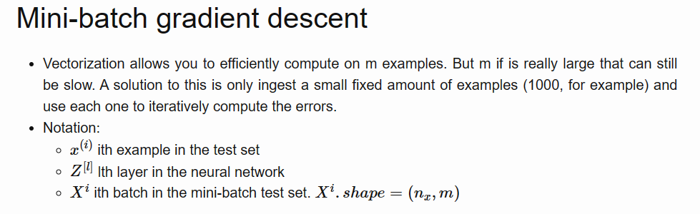
Mini-batch gradient descent
Vectorization allows you to efficiently compute on m examples.

Slide 11
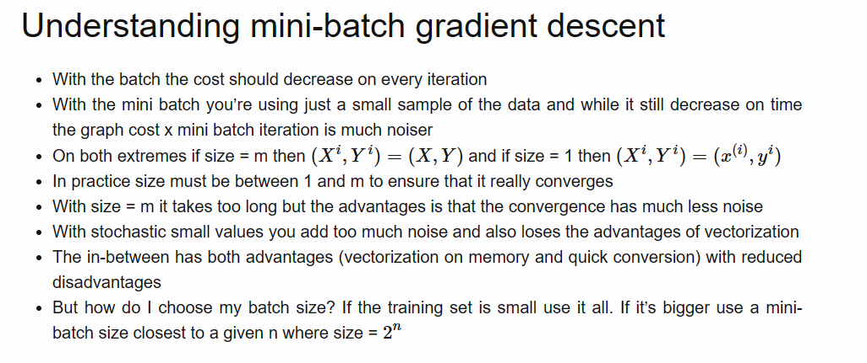
Mini-batch gradient descent

Slide 12
Optimization Algorithms
Understanding mini-batch gradient descent

Slide 13
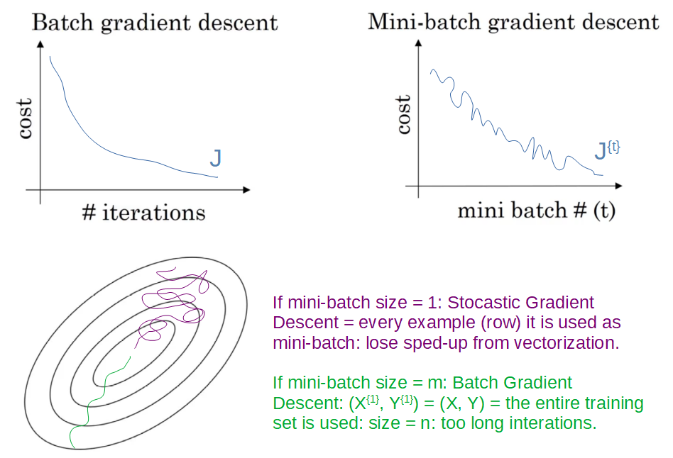
Training with mini batch gradient descent

Slide 14
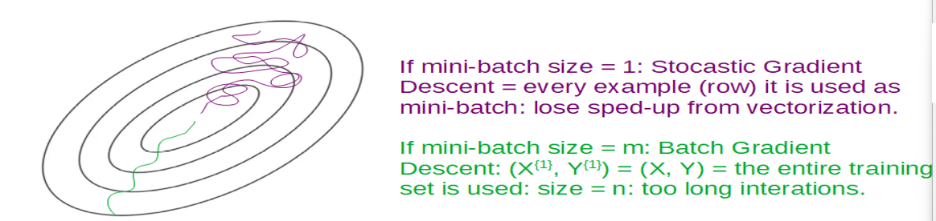
Choosing your mini-batch size

Slide 15
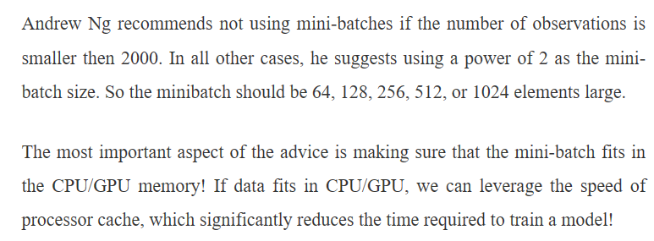
Choosing your mini-batch size

Slide 16
Optimization Algorithms
Exponentially weighted averages

Slide 17
Exponentially weighted averages
Exponentially weighted averages (EWAs) are a way to compute a moving average of a sequence of data points that assigns exponentially decreasing weights to the previous values in the sequence. This means that more recent data points are given more weight than older ones.
The formula for computing the exponentially weighted average is given by
V_{t} = βV_{t-1} + (1-β)θ_{t}
where β is a parameter between 0 and 1 that controls the weight given to the previous average, V_{t-1}, and the current data point, θ_{t}. The parameter β is often referred to as the smoothing factor and is a hyperparameter that can be tuned to obtain the desired results.

Slide 18
Exponentially weighted averages
The parameter β controls the trade-off between giving more weight to recent data points and smoothing out the sequence. When β is close to 1, the exponentially weighted average will give a lot of weight to the previous value, resulting in a smoother sequence that adapts more slowly to changes in the data. When β is close to 0, the exponentially weighted average will give more weight to the current value, resulting in a more volatile sequence that adapts more quickly to changes in the data.
Exponentially weighted averages are commonly used in time series analysis, finance, and machine learning, as they provide a simple way to compute a smoothed version of a sequence of data that responds quickly to changes in the data while avoiding overfitting to noisy or spurious data points.

Slide 19
Exponentially weighted averages
Consider example of the daily temperature of London from the last year is taken as the sequence of data points. The goal is to compute the moving average of the temperature over a certain window of time, which is done by taking an exponentially weighted average.

Slide 20
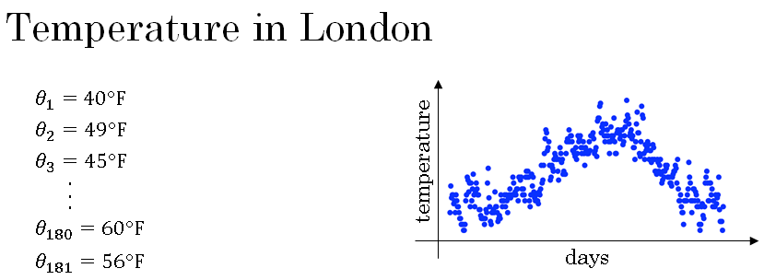

Slide 21
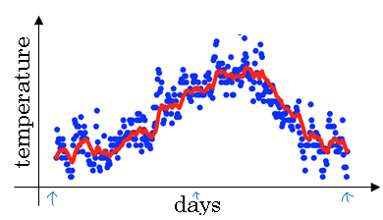
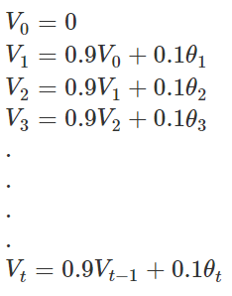

Slide 22
Exponentially weighted averages
When β is close to 1, as in the case of β=0.98, the exponentially weighted average is computed over a longer window of time, and hence the resulting curve is smoother. However, it also means that the curve adapts more slowly to changes in the temperature. When β is close to 0.5, as in the case of β=0.5, the exponentially weighted average is computed over a shorter window of time, resulting in a noisier curve that is more susceptible to outliers. However, it adapts more quickly to changes in the temperature.
The choice of β depends on the nature of the data and the desired level of smoothing. By varying the value of β, one can obtain different levels of smoothing and adaptation to changes in the data. The exponentially weighted average is a widely used technique in signal processing, finance, and machine learning, where it is used in optimization algorithms that are faster than gradient descent.

Slide 23
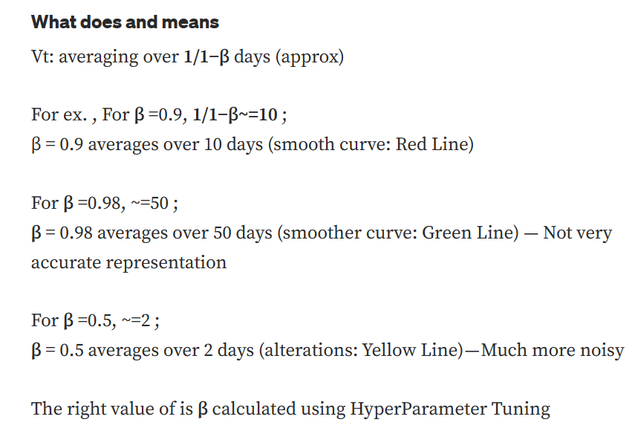
Exponentially weighted averages

Slide 24
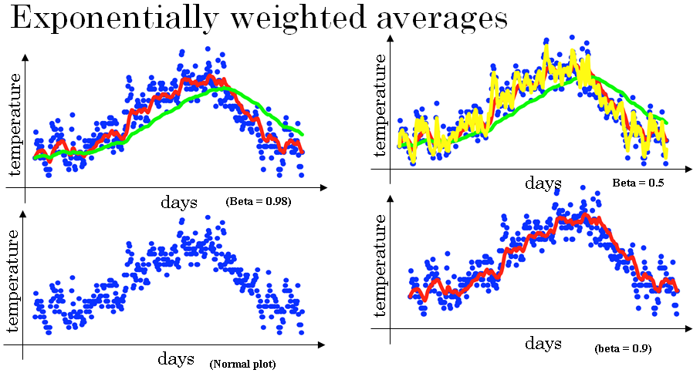

Slide 25
Optimization Algorithms
Understanding exponentially weighted averages

Slide 26
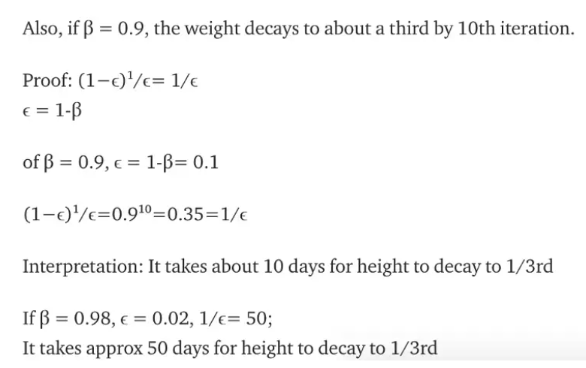
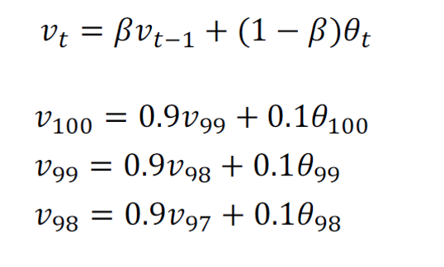
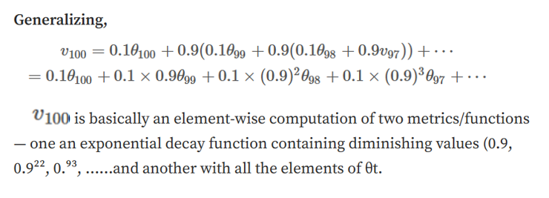
Exponentially weighted averages

Slide 27
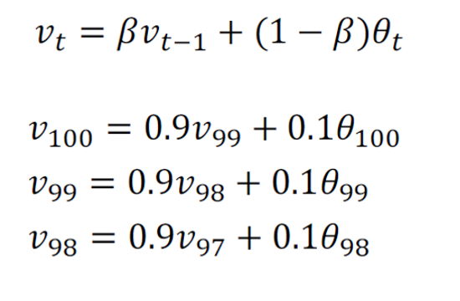
Implementing exponentially weighted averages

Slide 28
Exponentially weighted averages
The intuition behind the EWA algorithm is that it is like computing a moving average of the time series data but with an exponentially decaying weight for each data point. As beta gets closer to 1, the EWA algorithm focuses more on recent data and adapts more slowly to changes in the time series. Conversely, as beta gets smaller, the EWA algorithm focuses more on older data and adapts more quickly to changes in the time series.
One advantage of the EWA algorithm is that it takes up very little memory since only one row number needs to be stored in memory at any given time. This makes it an efficient and simple way to compute averages of time series data, especially when there are a large number of variables to compute averages for.

Slide 29
Optimization Algorithms
Bias correction in exponentially
weighted average

Slide 30
Bias correction in exponentially
weighted average
Exponentially weighted moving averages are a key component of several optimization algorithms used in training neural networks. As discussed in the previous video, the basic idea is to calculate an exponentially weighted average of a parameter by giving more weight to recent values and less weight to older values. This can be useful in smoothing noisy data and tracking trends.
However, when implementing this algorithm, there is a technical detail called bias correction that can make the computation of these averages more accurate, especially during the initial phase of learning. When implementing a moving average, we typically initialize it with V₀ equals 0, and then calculate V_{t} using the formula:
V_{t} = βV_{t-1} + (1-β)θ_{t}

Slide 31
Bias correction in exponentially
weighted average
But when we calculate V_{t} using this formula, it can result in a bias towards lower values, especially during the initial phase of learning. This is because the first few values of V_{t} are calculated using a small number of θ_{t} values, which can cause the moving average to underestimate the true value of the parameter.
To correct for this bias, we can modify the estimate of V_{t} by dividing it by a correction factor, which is 1-β^{t}. This correction factor ensures that the estimate is normalized and takes into account the fact that we are using a smaller number of θ_{t} values during the initial phase of learning. By doing this, we can obtain a more accurate estimate of the parameter during the initial phase of learning.

Slide 32
Bias correction in exponentially
weighted average
In practice, bias correction is not always used in machine learning because it can be computationally expensive and most people are willing to tolerate some bias during the initial phase of learning. However, if accuracy is important during the initial phase of learning, then bias correction can be a useful tool.
Overall, exponentially weighted moving averages and bias correction are important concepts to understand in machine learning because they can be used to optimize the training of neural networks and other models. By understanding these concepts, we can better understand how to use these optimization algorithms to improve the accuracy and efficiency of our models.

Slide 33
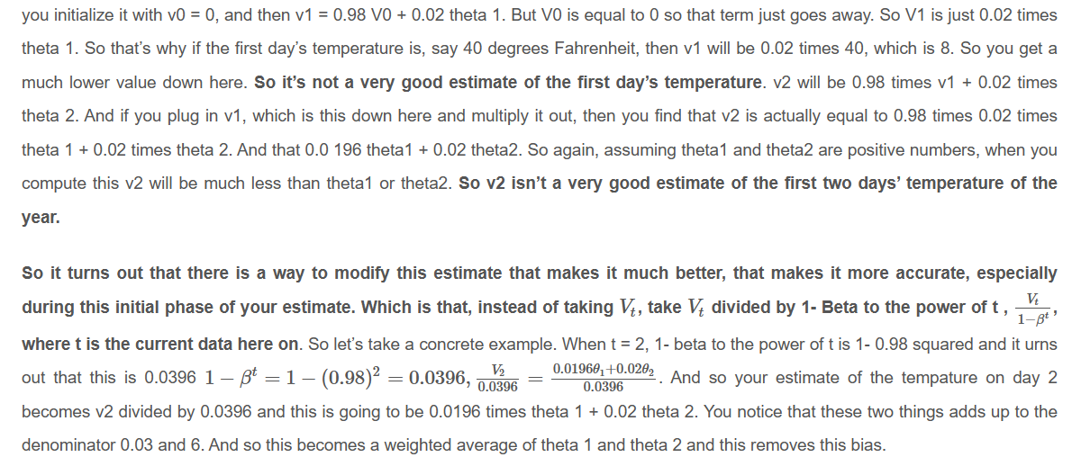
Bias correction

Slide 34
Optimization Algorithms
Gradient descent with momentum

Slide 35
Gradient descent with momentum
An algorithm called momentum, or gradient descent with momentum that almost always works faster than the standard gradient descent algorithm.
The basic idea is to compute an exponentially weighted average of gradients and use that to update weights instead of using the derivative directly.
The goal is to prevent oscillations and enable faster learning in the horizontal direction while slowing down the oscillations in the vertical direction.
Another way of viewing this problem is that on the vertical axis you want your learning to be a bit slower, because you don't want those oscillations. But on the horizontal axis, you want faster learning. because you want it to aggressively move from left to right, toward that minimum, toward that red dot. This can be achieved with gradient descent with momentum.

Slide 36
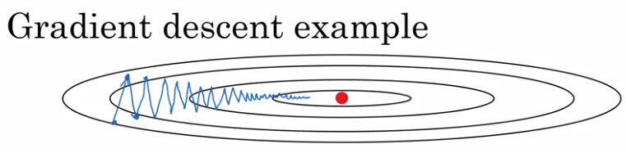

Gradient descent with momentum

Slide 37
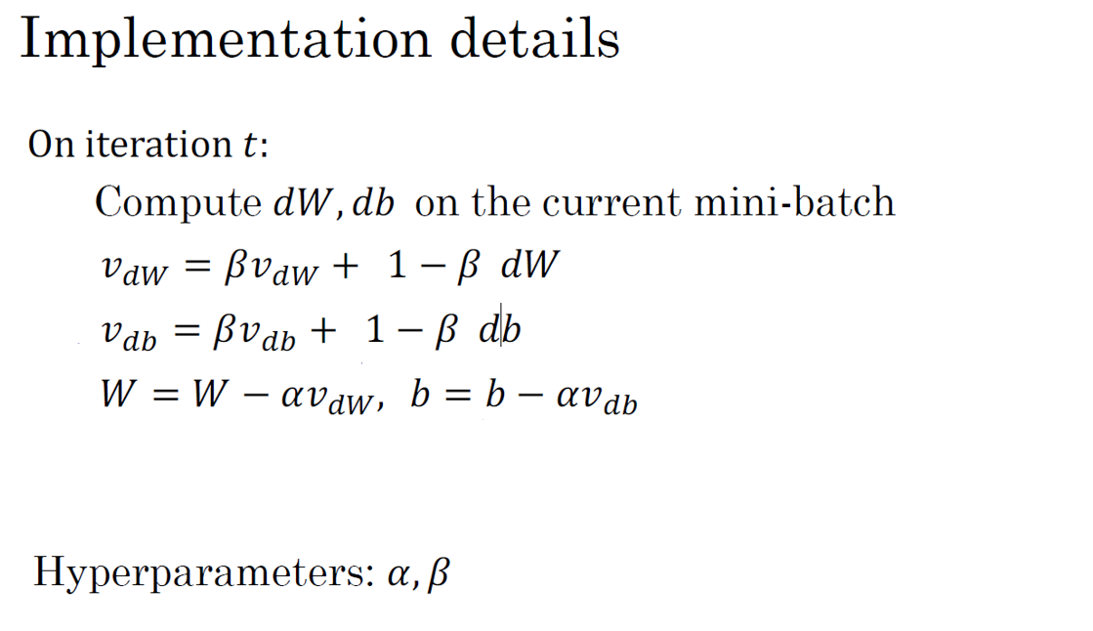

Slide 38
Optimization Algorithms
RMSprop

Slide 39
RMSprop
RMSprop is an optimization algorithm that can speed up gradient descent. It works by keeping an exponentially weighted average of the squares of the derivatives for each parameter. This average is then used to adjust the learning rate for each parameter during the update step.
RMSprop is particularly effective at reducing oscillations in the vertical direction, where the function is sloped more steeply. This is achieved by dividing the update for each parameter by a larger number in the vertical direction than in the horizontal direction.

Slide 40
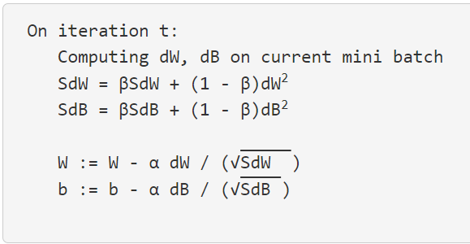
RMSprop

Slide 41
RMSprop
In practice, RMSprop is used in high-dimensional parameter spaces, where the oscillations may be present in a subset of parameters. By taking the squared derivatives of these parameters, RMSprop can dampen the oscillations and speed up the learning process.
To ensure numerical stability, a very small epsilon value is added to the denominator to prevent division by zero or very small numbers.
RMSprop was first introduced in a Coursera course taught by Jeff Hinton and has since become a widely used optimization algorithm in deep learning.

Slide 42
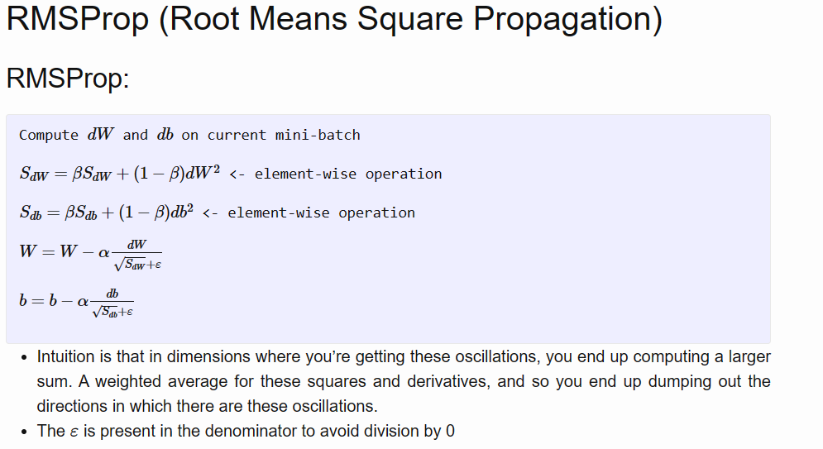
RMSprop

Slide 43
Optimization Algorithms
Adam optimization algorithm

Slide 44
Adam optimization algorithm
The field of deep learning has seen many optimization algorithms proposed over time, but few have been shown to work well across a wide range of neural networks. Gradient descent with momentum has been a popular and effective algorithm, and RMSprop and Adam have been two algorithms that have also been shown to work well across a wide range of deep learning architectures.
Adam (stands for Adaptive Moment Estimation) is an optimization algorithm that combines the effect of gradient descent with momentum and gradient descent with RMSprop. The algorithm has several hyperparameters, including the learning rate α, β₁, β₂, and epsilon. The default values for β₁ and β₂ are 0.9 and 0.999, respectively, and the recommended value for ϵ is 10⁻⁸.

Slide 45
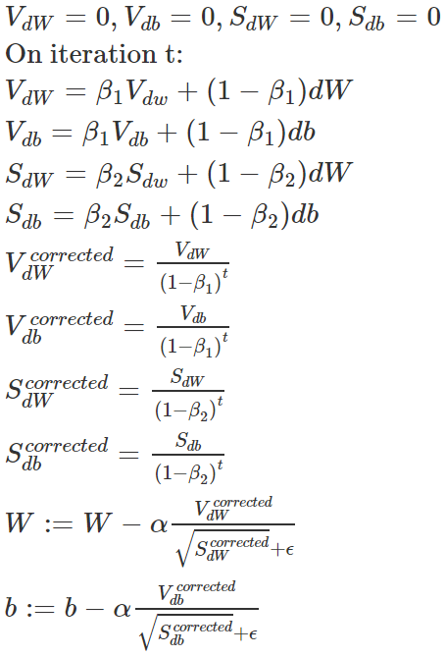
Adam optimization algorithm

Slide 46
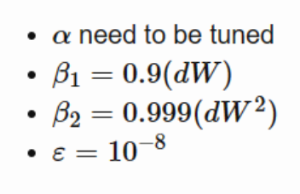

Hyperparameters choice:
Adam Coates

Slide 47
Adam optimization algorithm
β₁ is used to compute the mean of the derivatives (called the first moment) and β₂ is used to compute the exponentially weighted average of the squares (called the second moment). The bias correction is also implemented in Adam to improve numerical stability.
Hyperparameter tuning is an important step in optimizing the performance of deep learning models. In practice, it is common to use default values for β₁, β₂, and ϵ, and to tune the learning rate α by trying a range of values to see what works best.

Slide 48
Optimization Algorithms
Learning rate decay

Slide 49
Learning rate decay
Learning rate decay is a technique used to gradually reduce the learning rate α over time during the training process of a neural network. The intuition behind this technique is that as learning approaches convergence, having a slower learning rate allows for smaller and more precise steps towards the minimum instead of oscillating around it.
To implement learning rate decay, you can set the learning rate α to be equal to 1 over 1 plus a parameter called the decay rate times the epoch number, which is the number of times the algorithm passes through the data. The decay rate becomes another hyperparameter that you may need to tune. There are several other ways to implement learning rate decay, such as exponential decay or discrete staircase.

Slide 50
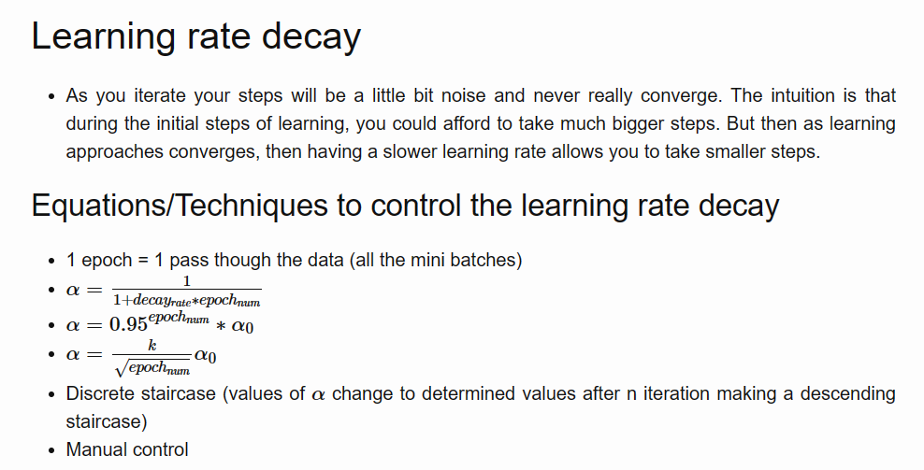
Learning rate decay

Slide 51
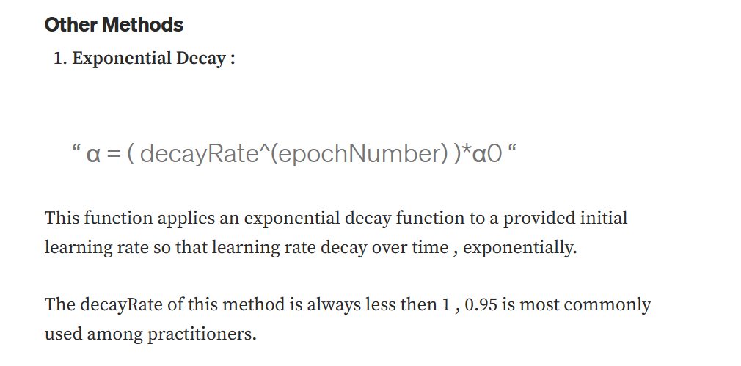
Other learning rate decay methods

Slide 52
Learning rate decay
It's essential to note that learning rate decay is not always necessary and should be considered lower down on the list of hyperparameters to try. Instead, setting a fixed value for Alpha and tuning it well can have a significant impact on the training process. However, learning rate decay can help speed up training in some cases.
Additionally, in the training process of a neural network, optimization algorithms aim to find a global minimum, but they can get stuck in local optima or saddle points, which are points where the gradient is close to zero in several dimensions, making it challenging to continue the descent. Understanding these types of optimization problems can help develop better intuitions about the training process of neural networks.

Slide 53
Optimization Algorithms
The problem of local optima

Slide 54
The problem of local optima
In the early days of deep learning, people used to worry a lot about the optimization algorithm getting stuck in bad local optima. However, as the theory of deep learning has advanced, our understanding of local optima has also changed.
It turns out that most points of zero gradient in a cost function are not local optima but saddle points. In a very high-dimensional space, for a point to be a local optima, all directions must look like a convex light function or a concave light function, which is very unlikely.

Slide 55
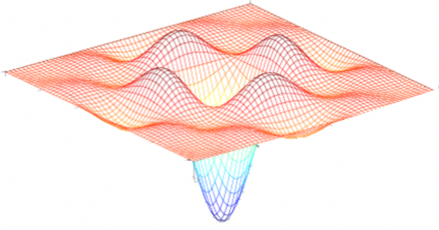
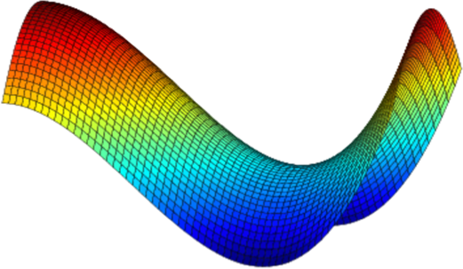
Local optima in neural networks

Slide 56
The problem of local optima
Instead, you're much more likely to encounter saddle points where the gradient is zero, and some directions have the curve bending up while others bend down. Plateaus are a bigger problem because they can slow down learning. Plateaus are regions where the derivative is close to zero for a long time, and gradient descent can take a long time to slowly find its way off the plateau.
Algorithms like momentum, RMSProp, or Adam can help your learning algorithm in these scenarios. In general, because neural networks are solving optimization problems over such high-dimensional spaces, our intuition about low-dimensional spaces does not transfer to these spaces, and our understanding of them is still evolving.

Slide 57
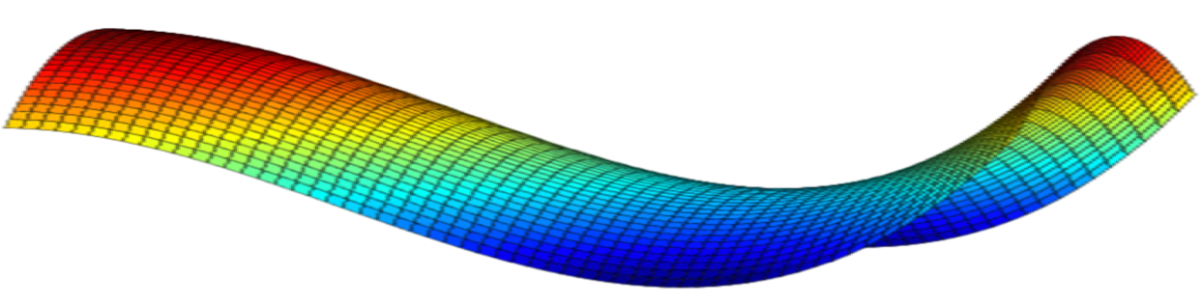


Problem of plateaus
Unlikely to get stuck in a bad local optima
Plateaus can make learning slow

